Slide 1
Web Services

Slide 2

What is Web Service
Web Service- W3C Definition
Web Service is "a software system designed to support interoperable machine-to-machine interaction over a
network."
What is Web: An enormous interconnected network of resources, where a resource is a Uniform Resource Identifier (URI)-named data source such as a PDF-based document, a video stream, a Web page, or even an application
These resources can be accessed by using standard Internet protocols such as Hyper Text Transfer Protocol (HTTP) or Simple Mail Transfer Protocol (SMTP).

Slide 3
What is Web Service
Service: A server-based application or software component that exposes a resource to clients via an exchange of messages
Interoperability means for example, a Java based application on Windows can communicate with a .NET based application on Linux.
The communication can be done through a set of messages in XML or JSON format over HTTP protocol.

Slide 4
What is Web Service
3 Key points
Designed for machine-to-machine(or application-to- application) interaction
Should be interoperable- Not platform dependent
Should allow communication over a network
A client accesses a resource by exchanging messages with a Web service

Slide 5
What is Web Service
Request and Response formats are platform-independent.
Request
Application A
Web Service
Response
How does the application know the format of Request and Response ? A Web service offers a service definition
Request/Response
Format
Application A
Request Structure
Response Structure
Endpoint

Slide 6

Simple and Complex Web Services
Web services can be classified as simple or complex.
Simple Web services doesn’t interact with other web services (e.g., a standalone server-based application with a single function that returns the current time for a specified time zone).
In contrast, complex web services often interact with other Web
services.
For example, a generalized social network Web service might interact with Twitter and Facebook Web services to obtain and return to its client all Twitter and all Facebook information for a specific individual.
Complex Web services are also known as mashups because they mash
(combine) data from multiple Web services.

Slide 7
Key Terminologies
Request and Response
Message Exchange Format
XML and JSON
Service Provider or Server
Service Consumer or Client
Service Definition
Transport
HTTP and MQ

Slide 8
Key Terminologies
Request and Response
Request is an input to the web service and Response is the
output from a web service.
Message Exchange Format
XML and JSON
o Message exchange format signifies the format of the Request and
Response , like is it XML or JSON.
Service Provider and Service Consumer
Service Consumer
Service Provider
Application A
Web Service
Response

Slide 9
Service Provider and Service Consumer
WebService
Java Application
DotNet Application
PHP Application
Java Application, DotNet Application and PHP Application are Service consumers while WebService is the Service Provider

Slide 10
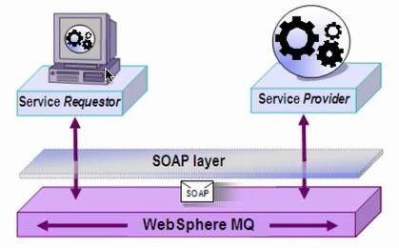
Service Definition
Service Definition:
Service definition is the contract between the service producer and service
consumer.
Endpoint describes where the service is available. It defines what URL the service is exposed at.
Transport:
Defines how a service is called. Is the service exposed over the web by
providing a url or is the service exposed over a message queue i.e.
communication over a queue.

Slide 11
SOAP Web Service RESTful Web Service

Slide 12
SOAP-based web services
SOAP (Simple Object Access Protocol) is a messaging protocol that allows programs that run on disparate operating systems (such as Windows and Linux) to communicate using Hypertext Transfer Protocol (HTTP) and its Extensible Markup Language (XML).

Slide 13
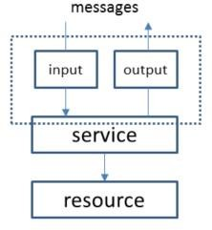
SOAP-based web services
An exchange of SOAP messages is called an operation, which corresponds to a function call and its response.
A Web service operation involves input and output messages

Slide 14
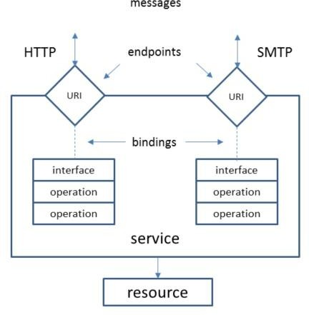
SOAP-based web services
Related operations are often grouped into an interface, which is conceptually similar to a Java interface.
A binding provides concrete details on how an interface is bound to a messaging protocol (particularly SOAP) to communicate commands, error codes, and other items over the wire.
The binding and a network address (an IP address and a port) URI is known as an endpoint, and a collection of endpoints is a Web service.
Interfaces of operations are
accessible via their endpoints

Slide 15
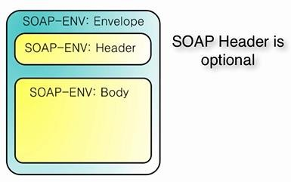
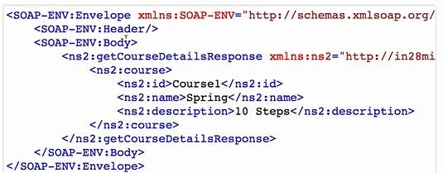
SOAP-based web services

Slide 16
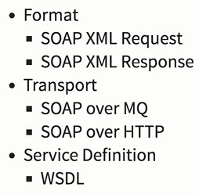
SOAP-based web services
SOAP is often used with Web Services Description Language (WSDL, pronounced whiz-dull), an XML language for defining a Web service's operations.

Slide 17
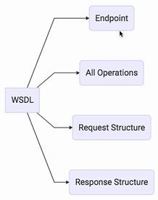
SOAP-based web services

Slide 18

RESTful web services
A RESTful Web Service is a widely used Web service category that's based on Representational State Transfer (REST), a software architecture style for distributed hypermedia systems(www) (systems in which images, text, and other resources are located around networks and are accessible via hyperlinks).

Slide 19

RESTful web services
The central part of REST is the URI-identifiable resource. REST identifies resources by their Multipurpose Internet Mail Extensions (MIME) types (such as text/xml).
When a client requests a resource from a RESTful Web service, the service sends a MIME-typed representation of the resource to the client.
Also, resources have states that are captured by their representations.
Clients use HTTP's POST, GET, PUT, and DELETE verbs to retrieve resource representations and to manipulate resources.

Slide 20

RESTful web services
REST maps these verbs onto the database Create, Read, Update, and
Delete (CRUD) operations, as follows:
POST: Create new resource based on request data.
GET: Read existing resource without producing side effects (don't modify the resource).
PUT: Update existing resource with request data.
DELETE: Delete existing resource.
Each verb is followed by a URI that identifies the resource.
The URI might refer to a collection, such as
http://javajeff.ca/library,
Or to an element of the collection, such as
http://javajeff.ca/library/9781484219157

Slide 21

Resource Vs Endpoint
Resource is a RESTful subset of Endpoint.
An endpoint by itself is the location where a service can be accessed: https://www.google.com # Serves HTML
8.8.8.8 # Serves DNS
/services/service.asmx # Serves an ASP.NET Web Service
/api/users/johnny # Look up johnny from a users collection.
/v2/books/1234 # Get book with ID 1234 in API v2 schema.
All of the above could be considered service endpoints, but only the bottom group would be considered resources. The top group is not expressive regarding the content it provides.
A REST request is like a sentence composed of nouns (resources) and verbs (HTTP
methods GET/POST/PUT/DELETE):
GET (method) the user named johnny (resource).
DELETE (method) the book with id 1234 (resource).

Slide 22

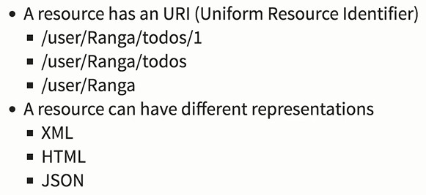
Building RESTful Web Services
The following principles encourage RESTful applications to be simple, lightweight, and fast:
Resource identification through URI: A RESTful web service exposes a set of resources that identify the targets of the interaction with its clients.
Resources are identified by URIs, which provide a global addressing space for resource and service discovery.

Slide 23

Building RESTful Web Services
Uniform interface: Resources are manipulated using a fixed set of four create, read, update, delete operations: PUT, GET, POST, and DELETE. PUT creates a new resource, which can be then deleted by using DELETE. GET retrieves the current state of a resource in some representation. POST transfers a new state onto a resource.

Slide 24

Building RESTful Web Services
Self-descriptive messages: Resources are decoupled from their representation so that their content can be accessed in a variety of formats, such as HTML, XML, plain text, PDF, JPEG, JSON, and others.
Stateful interactions through hyperlinks: Every interaction with a
resource is stateless; that is, request messages are self-contained.
Several techniques exist to exchange state, such as URI rewriting, cookies, and hidden form fields.
State can be embedded in response messages to point to valid future states of the interaction.

Slide 25

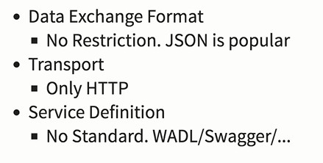
Building RESTful Web Services
Web Application Description Language (WADL)
Swagger is an open source software framework backed by a large ecosystem of tools that helps developers design, build, document, and consume RESTful Web services.

Slide 26

REST and SOAP
REST and SOAP are not competitors.
SOAP is actually a protocol, whereas REST is an architecture style.
What REST can be compared against is SOA and RPC. All three are
examples of web service styles, each with their own conceptual focus.
RPC is focused around operations, SOA around messages, and REST around resources.
SOAP-based Web services can be delivered over protocols such as HTTP, SMTP, FTP, and Blocks Extensible Exchange Protocol (BEEP).
Delivering SOAP messages over HTTP can be viewed as a special kind of
RESTful Web service.

Slide 27

REST and SOAP
In general we cannot count on different REST implementations to use HTTP in the same way at all, and HTTP verbs don't tell you anything about the representations they act on.
So, for any given REST service, there is a tremendous vacuum of information about how to use it.
There are bunch of ways to define a RESTful API just like WSDL for SOAP:
Google Discovery service format.
Mashery IODocs.
WADL.
Swagger.
Apiary.

Slide 28

Java EE Web Services Technologies
Java API for RESTful Web Services (JAX-RS)
This API provides support for RESTful (Representational State Transfer) Web services
in the Java platform.
Java API for XML-Based Web Services (JAX-WS)
The Java API for XML Web Services (JAX-WS) is the centerpiece of a newly re- architected API stack for Web services, the so-called "integrated stack" that includes JAX-WS 2.0, JAXB 2.0, and SAAJ 1.3. The integrated stack represents a logical re- architecture of Web services functionality in the Java WSDP. JAX-WS is designed to take the place of JAX-RPC in Web services and Web applications.
Java Architecture for XML Binding (JAXB)
Java Architecture for XML Binding (JAXB) provides a convenient way to bind an XML schema to a representation in Java code. This makes it easy for you to incorporate XML data and processing functions in applications based on Java technology without having to know much about XML itself.

Slide 29

Building RESTful Web Services with JAX-RS
JAX-RS is a Java programming language API designed to make it easy to develop applications that use the REST architecture.
The JAX-RS API uses Java programming language annotations to simplify
the development of RESTful web services.
Jersey, the reference implementation of JAX-RS, implements support for the annotations defined in JSR 311, making it easy for developers to build RESTful web services by using the Java programming language.

Slide 30

JAX-RS Annotations
Annotation | Description
@Path | The @Path annotation’s value is a relative URI path indicating where the Java class will be hosted: for example, /helloworld. You can also embed variables in the URIs to make a URI path template. For example, you could ask for the name of a user and pass it to the application as a variable in the URI: /helloworld/{username}.
@GET | The @GET annotation is a request method designator and corresponds to the similarly named HTTP method. The Java method annotated with this request method designator will process HTTP GET requests. The behavior of a resource is determined by the HTTP method to which the resource is responding.
@POST | The @POST annotation is a request method designator and corresponds to the similarly named HTTP method. The Java method annotated with this request method designator will process HTTP POST requests. The behavior of a resource is determined by the HTTP method to which the resource is responding.
@PUT | The @PUT annotation is a request method designator and corresponds to the similarly named HTTP method. The Java method annotated with this request method designator will process HTTP PUT requests. The behavior of a resource is determined by the HTTP method to which the resource is responding.

Slide 31

JAX-RS Annotations
Annotation | Description
@DELETE | The @DELETE annotation is a request method designator and corresponds to the similarly named HTTP method. The Java method annotated with this request method designator will process HTTP DELETE requests. The behavior of a resource is determined by the HTTP method to which the resource is responding.
@HEAD | The @HEAD annotation is a request method designator and corresponds to the similarly named HTTP method. The Java method annotated with this request method designator will process HTTP HEAD requests. The behavior of a resource is determined by the HTTP method to which the resource is responding.
@PathParam | The @PathParam annotation is a type of parameter that you can extract for use in your resource class. URI path parameters are extracted from the request URI, and the parameter names correspond to the URI path template variable names specified in the @Path class-level annotation.
@QueryParam | The @QueryParam annotation is a type of parameter that you can extract for use in your resource class. Query parameters are extracted from the request URI query parameters.
@Consumes | The @Consumes annotation is used to specify the MIME media types of representations a resource can consume that were sent by the client.

Slide 32

JAX-RS Annotations
@Produces | The @Produces annotation is used to specify the MIME media types of representations a resource can produce and send back to the client: for example, "text/plain".
@Provider | The @Provider annotation is used for anything that is of interest to the JAX-RS runtime, such as MessageBodyReader and MessageBodyWriter Providers are a simply a way of extending and customizing the JAX-RS runtime. JAX-RS runtime comes with a number of predefined providers that will be responsible for implementing a base level of functionality (e.g for mapping to and from XML, translating the most common exceptions etc etc). You can also create your own providers as needed.

Slide 33

Overview of a JAX-RS Application
import javax.ws.rs.GET; import javax.ws.rs.Produces; import javax.ws.rs.Path;
// The Java class will be hosted at the URI path "/helloworld" @Path("/helloworld")
public class HelloWorldResource {
// The Java method will process HTTP GET requests
@GET
// The Java method will produce content identified by the MIME Media type "text/plain"
@Produces("text/plain")
public String getClichedMessage() {
// Return some textual content
return "Hello World";
}
}

Slide 34

Thank You!

